Slide 1
W4111 – Introduction to Databases Section 002, Spring 2025 Lecture 6: ER(5), Relational(5), SQL(5)
© Donald F. Ferguson, 2025

Slide 2

Today’s Contents
2 | COMS W4111_002_2025_1 - Lecture 6: ER(5), Relational(5), SQL(5) © Donald F. Ferguson, 2025

Slide 3
Contents
Introduction and course updates
ER Model/ER Modeling
Roles
Aggregation
SQL
Functions, Procedures, Triggers
Authorization
Some advanced SQL: window functions, recursive queries
Relational/Database and Applications
Some basic concepts: connection, driver/connector, session, … …
Using transactions
“Web” application structure. REST, 3-tier application, SOLID
Object Relational Mapping
Some worked examples

Slide 4
Introduction and course updates
4 | COMS W4111_002_2025_1 - Lecture 6: ER(5), Relational(5), SQL(5) © Donald F. Ferguson, 2025

Slide 5
Course Updates
Project data set:
I recommend that both tracks use the IMDB and Game-of-Thrones dataset that I use in my examples.
But, you may choose your own dataset. I will publish requirements on your dataset tonight or tomorrow. You will describe your dataset in HW3B submission.
HW3B:
Very simple. Basically extend my examples and execute.
You will have to do some new DB concepts, e.g. create views.
Midterm:
In class, 14-MAR from 10:20 to 11:40. Please arrive by 10:10.
I will cancel the 2nd half of the lecture. You may be tired and need a break from DBs.

Slide 6
ER Modeling
6 | COMS W4111_002_2025_1 - Lecture 6: ER(5), Relational(5), SQL(5) © Donald F. Ferguson, 2025

Slide 7
Miscellaneous Topics
Introduction
7 | COMS W4111_002_2025_1 - Lecture 6: ER(5), Relational(5), SQL(5) © Donald F. Ferguson, 2025

Slide 8
Roles
Entity sets of a relationship need not be distinct
Each occurrence of an entity set plays a “role” in the relationship
The labels “course_id” and “prereq_id” are called roles.

Slide 9
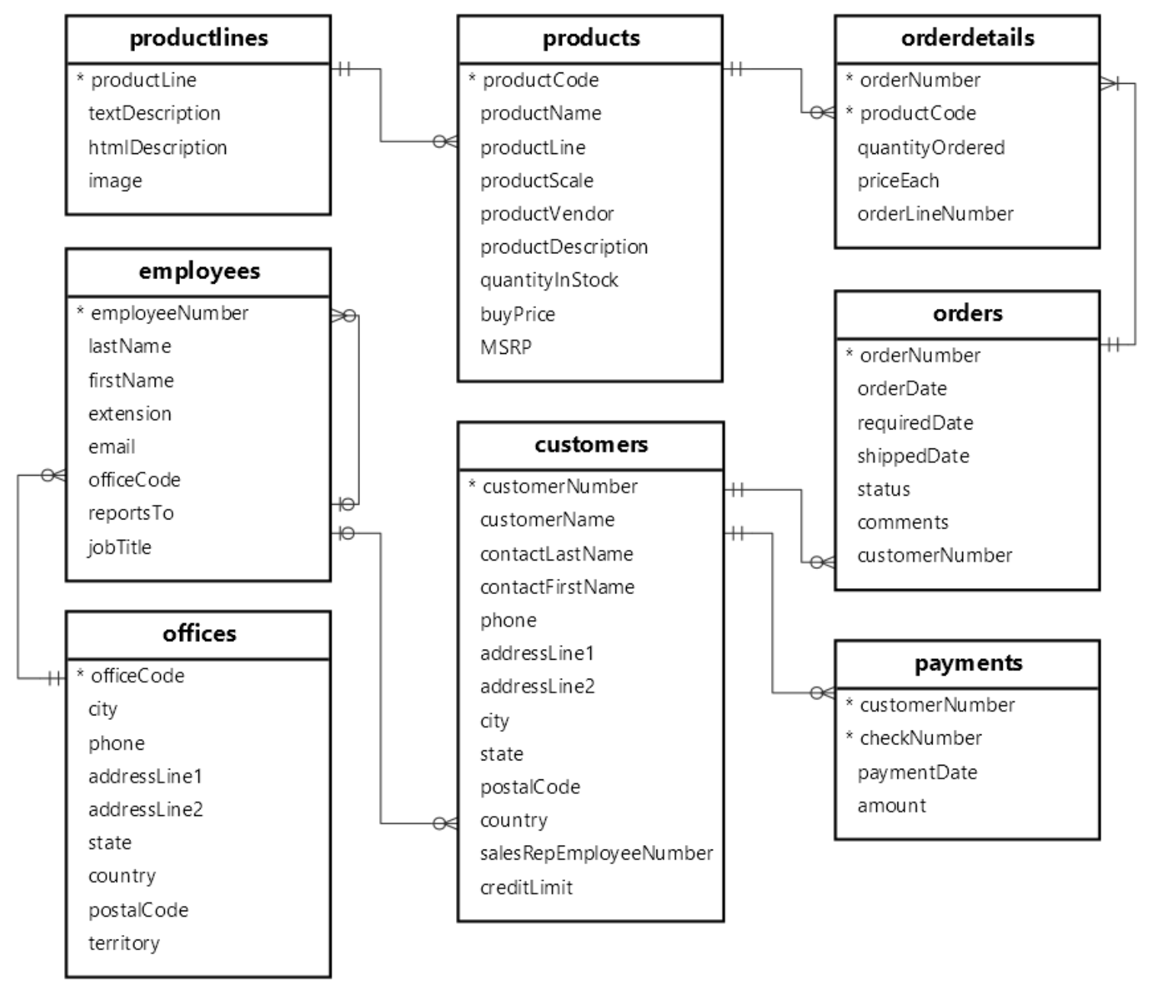
A Common Example
Hierarchies and organizations are a common example of relationships with a single entity.
In classicmodels, we see this in employees.
“reportsTo” is a “foreign” key to
“employeeId”
An interesting question is … “Who does the CEO report to?”
What value do you set for reportTo?
What is the implication for column constraints?

Slide 10
E-R Design Decisions
The use of an attribute or entity set to represent an object.
Whether a real-world concept is best expressed by an entity set or a relationship set.
The use of a ternary relationship versus a pair of binary relationships.
The use of a strong or weak entity set.
The use of specialization/generalization – contributes to modularity in the design.
The use of aggregation – can treat the aggregate entity set as a single unit without concern for the details of its internal structure.

Slide 11
Aggregation
Introduction
11 | COMS W4111_002_2025_1 - Lecture 6: ER(5), Relational(5), SQL(5) © Donald F. Ferguson, 2025

Slide 12
Aggregation
Consider the ternary relationship proj_guide, which we saw earlier
Suppose we want to record evaluations of a student by a guide on a project

Slide 13
Aggregation (Cont.)
Relationship sets eval_for and proj_guide represent overlapping information
Every eval_for relationship corresponds to a proj_guide relationship
However, some proj_guide relationships may not correspond to any eval_for relationships
So we can’t discard the proj_guide relationship
Eliminate this redundancy via aggregation
Treat relationship as an abstract entity
Allows relationships between relationships
Abstraction of relationship into new entity

Slide 14
Aggregation (Cont.)
Eliminate this redundancy via aggregation without introducing redundancy, the following diagram represents:
A student is guided by a particular instructor on a particular project
A student, instructor, project combination may have an associated evaluation
The simplest way to handle in relational is an associative entity.
Some thoughts here: https://www.geeksforgeeks.org/aggregate-data-model-in-nosql/
Notes:
14

Slide 15
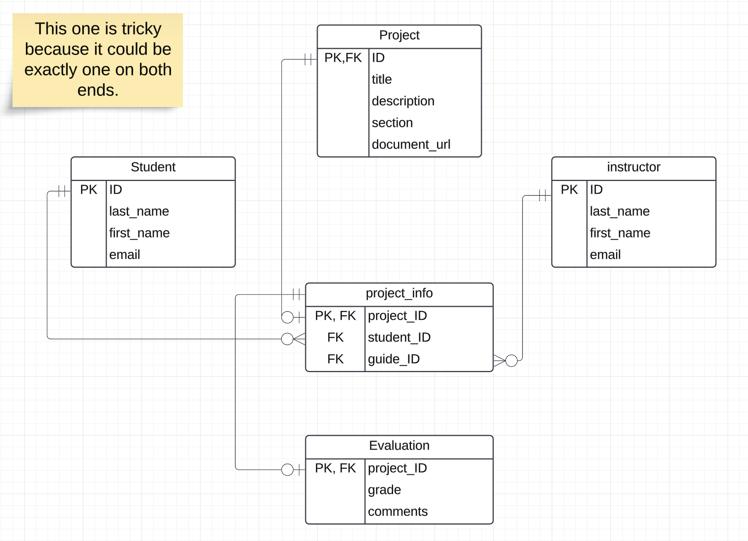
First Pass Implementation
project-project_info is tricky
They both exist and reference each other or do not.
But, I can create only one entity at a time.
Mandatory on both ends does not work.
I made the assumption that a project definition could exist, and then the “team” forms.

Slide 16
Reduction to Relational Schemas
To represent aggregation, create a schema containing
Primary key of the aggregated relationship,
The primary key of the associated entity set
Any descriptive attributes
In our example:
The schema eval_for is:
eval_for (s_ID, project_id, i_ID, evaluation_id)
The schema proj_guide is redundant.

Slide 17
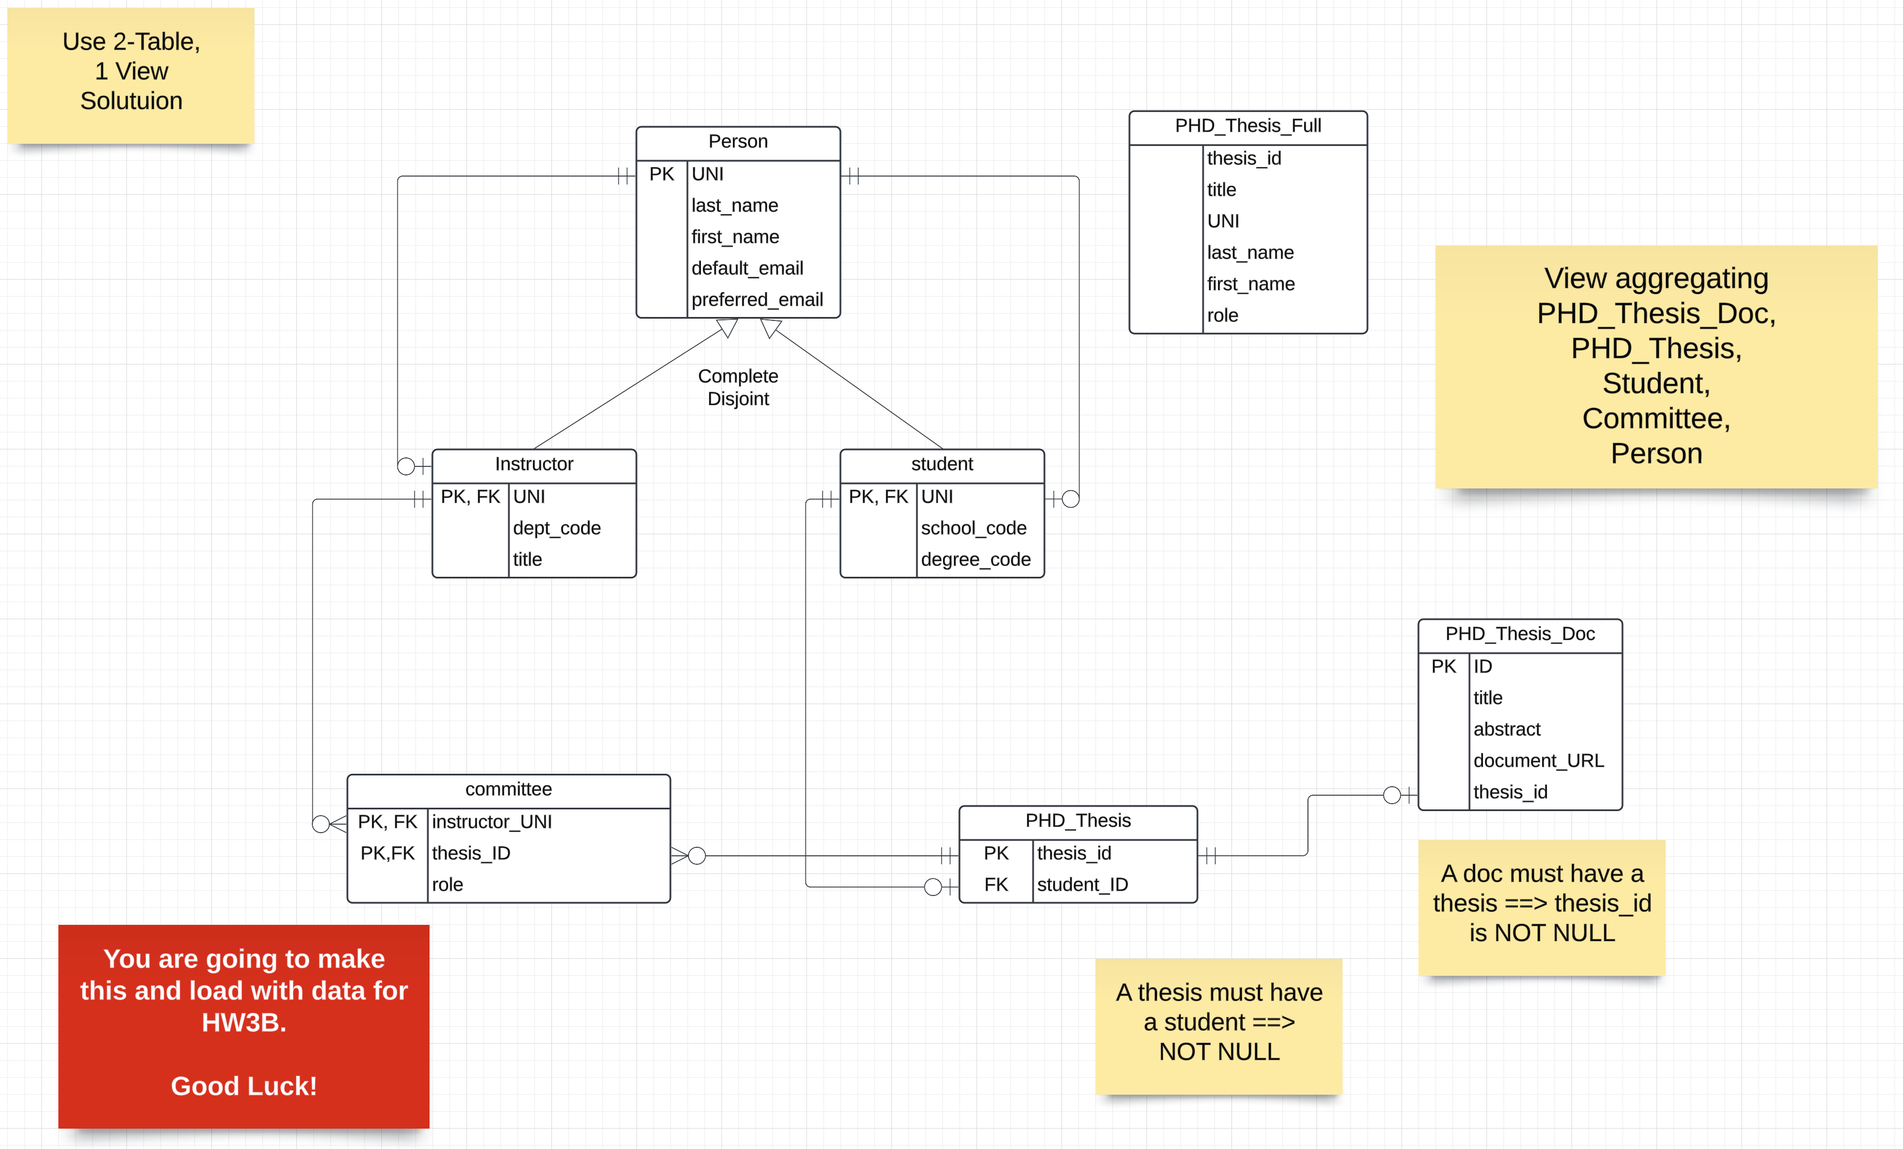
Let’s Do a More Example in Crow’s Foot
If I got that right, it is a miracle. Normally, you cannot be sure until you implement and test it.

Slide 18
SQL
18 | COMS W4111_002_2025_1 - Lecture 6: ER(5), Relational(5), SQL(5) © Donald F. Ferguson, 2025

Slide 19

Functions and Procedures
19 | COMS W4111_002_2025_1 - Lecture 6: ER(5), Relational(5), SQL(5) © Donald F. Ferguson, 2025

Slide 20
Functions and Procedures
Functions and procedures allow “business logic” to be stored in the database and executed from SQL statements.
These can be defined either by the procedural component of SQL or by an external programming language such as Java, C, or C++.
The syntax we present here is defined by the SQL standard.
Most databases implement nonstandard versions of this syntax.

Slide 21
Declaring SQL Functions
Define a function that, given the name of a department, returns the count of the number of instructors in that department.
create function dept_count (dept_name varchar(20)) returns integer begin declare d_count integer; select count (* ) into d_count from instructor where instructor.dept_name = dept_name return d_count; end
The function dept_count can be used to find the department names and budget of all departments with more that 12 instructors.
select dept_name, budget from department where dept_count (dept_name ) > 12

Slide 22
Table Functions
The SQL standard supports functions that can return tables as results; such functions are called table functions
Example: Return all instructors in a given department
create function instructor_of (dept_name char(20))
returns table (
ID varchar(5), name varchar(20), dept_name varchar(20), salary numeric(8,2))
return table (select ID, name, dept_name, salary from instructor where instructor.dept_name = instructor_of.dept_name)
Usage
select * from table (instructor_of ('Music'))

Slide 23
Language Constructs (Cont.)
For loop
Permits iteration over all results of a query
Example: Find the budget of all departments declare n integer default 0; for r as select budget from department where dept_name = 'Music' do set n = n + r.budget end for

Slide 24
Language Constructs for Procedures & Functions
SQL supports constructs that gives it almost all the power of a general-purpose programming language.
Warning: most database systems implement their own variant of the standard syntax below.
Compound statement: begin … end,
May contain multiple SQL statements between begin and end.
Local variables can be declared within a compound statements
While and repeat statements:
while boolean expression do
sequence of statements ;
end while
repeat
sequence of statements ;
until boolean expression
end repeat

Slide 25
Language Constructs – if-then-else
Conditional statements (if-then-else)
if boolean expression then statement or compound statement elseif boolean expression then statement or compound statement else statement or compound statement end if

Slide 26
Triggers
26 | COMS W4111_002_2025_1 - Lecture 6: ER(5), Relational(5), SQL(5) © Donald F. Ferguson, 2025

Slide 27
Triggers
A trigger is a statement that is executed automatically by the system as a side effect of a modification to the database.
To design a trigger mechanism, we must:
Specify the conditions under which the trigger is to be executed.
Specify the actions to be taken when the trigger executes.
Triggers introduced to SQL standard in SQL:1999, but supported even earlier using non-standard syntax by most databases.
Syntax illustrated here may not work exactly on your database system; check the system manuals

Slide 28
Triggering Events and Actions in SQL
Triggering event can be insert, delete or update
Triggers on update can be restricted to specific attributes
For example, after update of takes on grade
Values of attributes before and after an update can be referenced
referencing old row as : for deletes and updates
referencing new row as : for inserts and updates
Triggers can be activated before an event, which can serve as extra constraints. For example, convert blank grades to null.
create trigger setnull_trigger before update of takes referencing new row as nrow for each row when (nrow.grade = ' ') begin atomic set nrow.grade = null; end;

Slide 29
Trigger to Maintain credits_earned value
create trigger credits_earned after update of takes on (grade) referencing new row as nrow referencing old row as orow for each row when nrow.grade <> 'F' and nrow.grade is not null and (orow.grade = 'F' or orow.grade is null) begin atomic update student set tot_cred= tot_cred + (select credits from course where course.course_id= nrow.course_id) where student.id = nrow.id; end;

Slide 30
Statement Level Triggers
Instead of executing a separate action for each affected row, a single action can be executed for all rows affected by a transaction
Use for each statement instead of for each row
Use referencing old table or referencing new table to refer to temporary tables (called transition tables) containing the affected rows
Can be more efficient when dealing with SQL statements that update a large number of rows

Slide 31
When Not To Use Triggers
Triggers were used earlier for tasks such as
Maintaining summary data (e.g., total salary of each department)
Replicating databases by recording changes to special relations (called change or delta relations) and having a separate process that applies the changes over to a replica
There are better ways of doing these now:
Databases today provide built in materialized view facilities to maintain summary data
Databases provide built-in support for replication
Encapsulation facilities can be used instead of triggers in many cases
Define methods to update fields
Carry out actions as part of the update methods instead of through a trigger

Slide 32
When Not To Use Triggers (Cont.)
Risk of unintended execution of triggers, for example, when
Loading data from a backup copy
Replicating updates at a remote site
Trigger execution can be disabled before such actions.
Other risks with triggers:
Error leading to failure of critical transactions that set off the trigger
Cascading execution

Slide 33
Summary
33 | COMS W4111_002_2025_1 - Lecture 6: ER(5), Relational(5), SQL(5) © Donald F. Ferguson, 2025

Slide 34
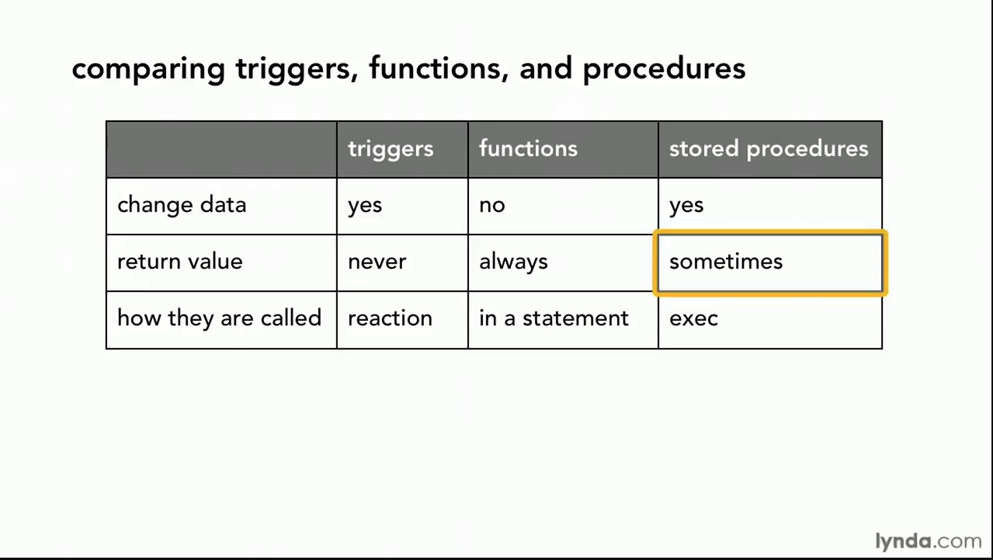
Comparison

Slide 35
Comparison – Some Details
A trigger has capabilities like a procedure, except ...
You do not call it. The DB engine calls it before or after an INSERT, UPDATE, DELETE.
The inputs are the list of incoming new, modified rows.
The outputs are the modified versions of the new or modified rows.

Slide 36
Authorization
36 | COMS W4111_002_2025_1 - Lecture 6: ER(5), Relational(5), SQL(5) © Donald F. Ferguson, 2025

Slide 37
Security Concepts (Terms from Wikipedia)
Definitions:
“A (digital) identity is information on an entity used by computer systems to represent an external agent. That agent may be a person, organization, application, or device.”
“Authentication is the act of proving an assertion, such as the identity of a computer system user. In contrast with identification, the act of indicating a person or thing's identity, authentication is the process of verifying that identity.”
“Authorization is the function of specifying access rights/privileges to resources, ... More formally, "to authorize" is to define an access policy. ... During operation, the system uses the access control rules to decide whether access requests from (authenticated) consumers shall be approved (granted) or disapproved.
“Within an organization, roles are created for various job functions. The permissions to perform certain operations are assigned to specific roles. Members or staff (or other system users) are assigned particular roles, and through those role assignments acquire the permissions needed to perform particular system functions.”
“In computing, privilege is defined as the delegation of authority to perform security-relevant functions on a computer system. A privilege allows a user to perform an action with security consequences. Examples of various privileges include the ability to create a new user, install software, or change kernel functions.”
SQL and relational database management systems implementing security by:
Creating identities and authentication policies.
Creating roles and assigning identities to roles.
Granting and revoking privileges to/from roles and identities.

Slide 38
Authorization
We may assign a user several forms of authorizations on parts of the database.
Read - allows reading, but not modification of data.
Insert - allows insertion of new data, but not modification of existing data.
Update - allows modification, but not deletion of data.
Delete - allows deletion of data.
Each of these types of authorizations is called a privilege. We may authorize the user all, none, or a combination of these types of privileges on specified parts of a database, such as a relation or a view.

Slide 39
Authorization (Cont.)
Forms of authorization to modify the database schema
Index - allows creation and deletion of indices.
Resources - allows creation of new relations.
Alteration - allows addition or deletion of attributes in a relation.
Drop - allows deletion of relations.

Slide 40
Authorization Specification in SQL
The grant statement is used to confer authorization
grant <privilege list> on <relation or view > to <user list>
<user list> is:
a user-id
public, which allows all valid users the privilege granted
A role (more on this later)
Example:
grant select on department to Amit, Satoshi
Granting a privilege on a view does not imply granting any privileges on the underlying relations.
The grantor of the privilege must already hold the privilege on the specified item (or be the database administrator).

Slide 41
Privileges in SQL
select: allows read access to relation, or the ability to query using the view
Example: grant users U₁, U₂, and U₃ select authorization on the instructor relation:
grant select on instructor to U₁, U₂, U₃
insert: the ability to insert tuples
update: the ability to update using the SQL update statement
delete: the ability to delete tuples.
all privileges: used as a short form for all the allowable privileges

Slide 42
Revoking Authorization in SQL
The revoke statement is used to revoke authorization.
revoke <privilege list> on <relation or view> from <user list>
Example:
revoke select on student from U₁, U₂, U₃
<privilege-list> may be all to revoke all privileges the revokee may hold.
If <revokee-list> includes public, all users lose the privilege except those granted it explicitly.
If the same privilege was granted twice to the same user by different grantees, the user may retain the privilege after the revocation.
All privileges that depend on the privilege being revoked are also revoked.

Slide 43
Roles
A role is a way to distinguish among various users as far as what these users can access/update in the database.
To create a role we use:
create a role <name>
Example:
create role instructor
Once a role is created we can assign “users” to the role using:
grant <role> to <users>

Slide 44
Roles Example
create role instructor;
grant instructor to Amit;
Privileges can be granted to roles:
grant select on takes to instructor;
Roles can be granted to users, as well as to other roles
create role teaching_assistant
grant teaching_assistant to instructor;
Instructor inherits all privileges of teaching_assistant
Chain of roles
create role dean;
grant instructor to dean;
grant dean to Satoshi;

Slide 45
Authorization on Views
create view geo_instructor as (select * from instructor where dept_name = 'Geology');
grant select on geo_instructor to geo_staff
Suppose that a geo_staff member issues
select * from geo_instructor;
What if
geo_staff does not have permissions on instructor?
Creator of view did not have some permissions on instructor?

Slide 46
Other Authorization Features
references privilege to create foreign key
grant reference (dept_name) on department to Mariano;
Why is this required?
transfer of privileges
grant select on department to Amit with grant option;
revoke select on department from Amit, Satoshi cascade;
revoke select on department from Amit, Satoshi restrict;
And more!
Note:
Like in many other cases, SQL DBMS have product specific variations.

Slide 47
Advanced Aggregation
Window Functions
47 | COMS W4111_002_2025_1 - Lecture 6: ER(5), Relational(5), SQL(5) © Donald F. Ferguson, 2025

Slide 48
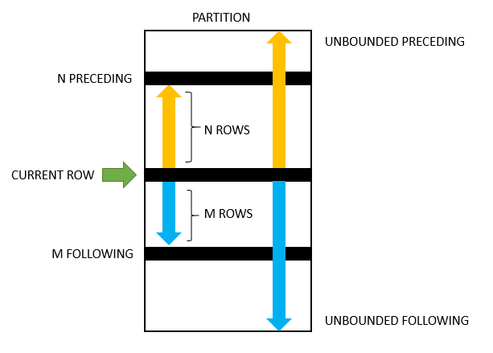
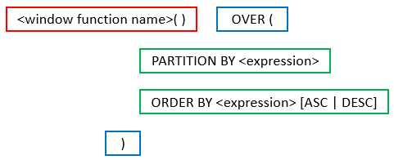
Advanced Aggregates and Window Functions
The aggregation functions in SQL are powerful.
There are some scenarios that are very difficult. SQL and databases add support for more advanced capabilities:
Ranking
Windows
Pivot, Slice and Dice, but we will cover these with a different technology (OLAP) later in the semester.
This is powerful, a little complex and requires trial and error.

Slide 49
Classic Models: Annual Revenue and YoY Growth by Country
SELECT country, YEAR(orderDate) AS year, ROUND(SUM(priceEach * quantityOrdered), 2) AS annual_revenue, ROUND( (SUM(priceEach * quantityOrdered) - LAG(SUM(priceEach * quantityOrdered)) OVER (PARTITION BY country ORDER BY YEAR(orderDate))) / LAG(SUM(priceEach * quantityOrdered)) OVER (PARTITION BY country ORDER BY YEAR(orderDate)) * 100, 2 ) AS yoy_growth_percentage FROM customers JOIN orders ON customers.customerNumber = orders.customerNumber JOIN orderdetails ON orders.orderNumber = orderdetails.orderNumber GROUP BY country, year ORDER BY country, year;

Slide 50
Revenue and Growth Quarter to Quarter
WITH quarterly_revenue AS (
SELECT
YEAR(o.orderDate) AS order_year, QUARTER(o.orderDate) AS order_quarter, SUM(od.quantityOrdered * od.priceEach) AS revenue
FROM
orders o JOIN orderdetails od ON o.orderNumber = od.orderNumber WHERE o.status = 'Shipped'
GROUP BY YEAR(o.orderDate), QUARTER(o.orderDate)
)
SELECT
qr.order_year, qr.order_quarter, qr.revenue,
LAG(qr.revenue) OVER (ORDER BY qr.order_year, qr.order_quarter) AS previous_quarter_revenue,
ROUND(
(qr.revenue - LAG(qr.revenue) OVER (ORDER BY qr.order_year, qr.order_quarter))
/ LAG(qr.revenue) OVER (ORDER BY qr.order_year, qr.order_quarter) * 100,
2
) AS qoq_growth_percent
FROM
quarterly_revenue qr
ORDER BY
qr.order_year, qr.order_quarter;

Slide 51
Recursive Queries
51 | COMS W4111_002_2025_1 - Lecture 6: ER(5), Relational(5), SQL(5) © Donald F. Ferguson, 2025

Slide 52
Recursion in SQL
SQL:1999 permits recursive view definition
Example: find which courses are a prerequisite, whether directly or indirectly, for a specific course with recursive rec_prereq(course_id, prereq_id) as ( select course_id, prereq_id from prereq union select rec_prereq.course_id, prereq.prereq_id, from rec_rereq, prereq where rec_prereq.prereq_id = prereq.course_id ) select ∗ from rec_prereq;
This example view, rec_prereq, is called the transitive closure of the prereq relation

Slide 53
The Power of Recursion
Recursive views make it possible to write queries, such as transitive closure queries, that cannot be written without recursion or iteration.
Intuition: Without recursion, a non-recursive non-iterative program can perform only a fixed number of joins of prereq with itself
This can give only a fixed number of levels of managers
Given a fixed non-recursive query, we can construct a database with a greater number of levels of prerequisites on which the query will not work
Alternative: write a procedure to iterate as many times as required
See procedure findAllPrereqs in book

Slide 54
The Power of Recursion
Computing transitive closure using iteration, adding successive tuples to rec_prereq
The next slide shows a prereq relation
Each step of the iterative process constructs an extended version of rec_prereq from its recursive definition.
The final result is called the fixed point of the recursive view definition.
Recursive views are required to be monotonic. That is, if we add tuples to prereq the view rec_prereq contains all of the tuples it contained before, plus possibly more

Slide 55
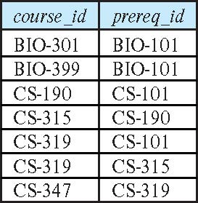
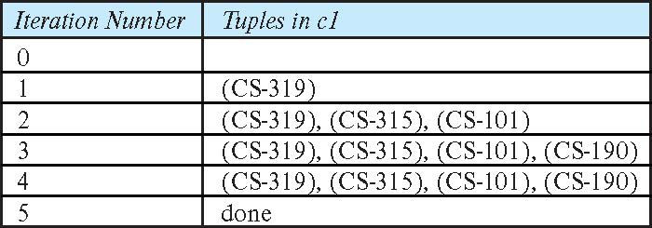
Example of Fixed-Point Computation

Slide 56
Classic Models Management Chain
WITH RECURSIVE employee_chain AS ( -- Base case: Start with employees who do not report to anyone (top-level managers) SELECT employeeNumber AS employee_id, reportsTo AS manager_id, CONCAT(firstName, ' ', lastName) AS employee_name, CAST(employeeNumber AS CHAR(100)) AS management_chain FROM employees WHERE reportsTo IS NULL UNION ALL -- Recursive step: Add employees who report to employees already in the chain SELECT e.employeeNumber AS employee_id, e.reportsTo AS manager_id, CONCAT(e.firstName, ' ', e.lastName) AS employee_name, CONCAT(ec.management_chain, ' -> ', e.employeeNumber) AS management_chain FROM employees e JOIN employee_chain ec ON e.reportsTo = ec.employee_id ) SELECT employee_id, employee_name, management_chain FROM employee_chain ORDER BY management_chain;

Slide 57

Recursive Query

Slide 58
Relational and Applications
58 | COMS W4111_002_2025_1 - Lecture 6: ER(5), Relational(5), SQL(5) © Donald F. Ferguson, 2025

Slide 59
Introduction
Introduction
59 | COMS W4111_002_2025_1 - Lecture 6: ER(5), Relational(5), SQL(5) © Donald F. Ferguson, 2025

Slide 60
Accessing SQL from a Programming Language
A database programmer must have access to a general-purpose programming language for at least two reasons
Not all queries can be expressed in SQL, since SQL does not provide the full expressive power of a general-purpose language.
Non-declarative actions -- such as printing a report, interacting with a user, or sending the results of a query to a graphical user interface -- cannot be done from within SQL.
Entering an address is an example that I use in my cloud computing course.

Slide 61
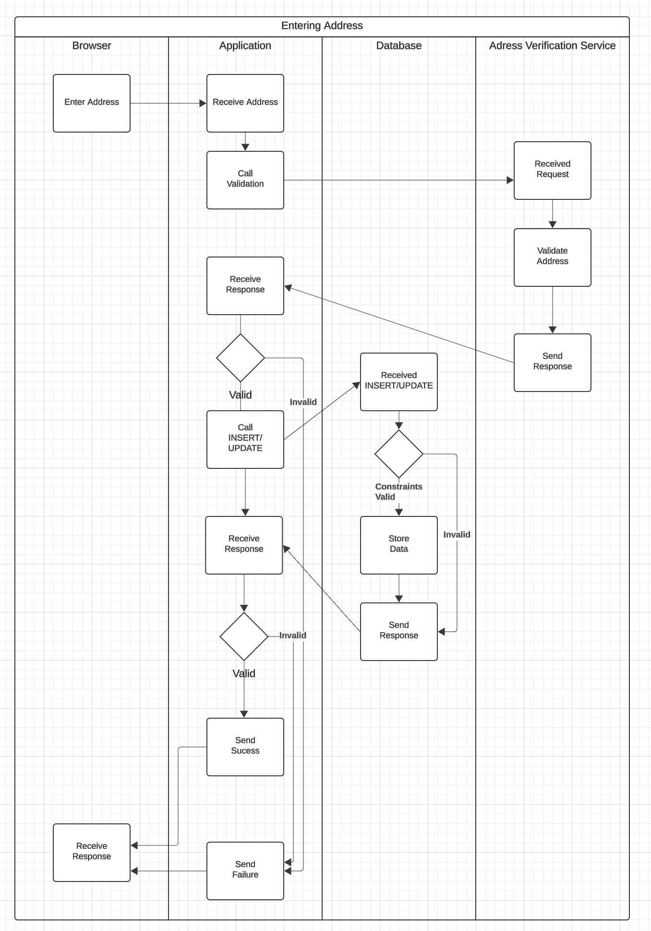
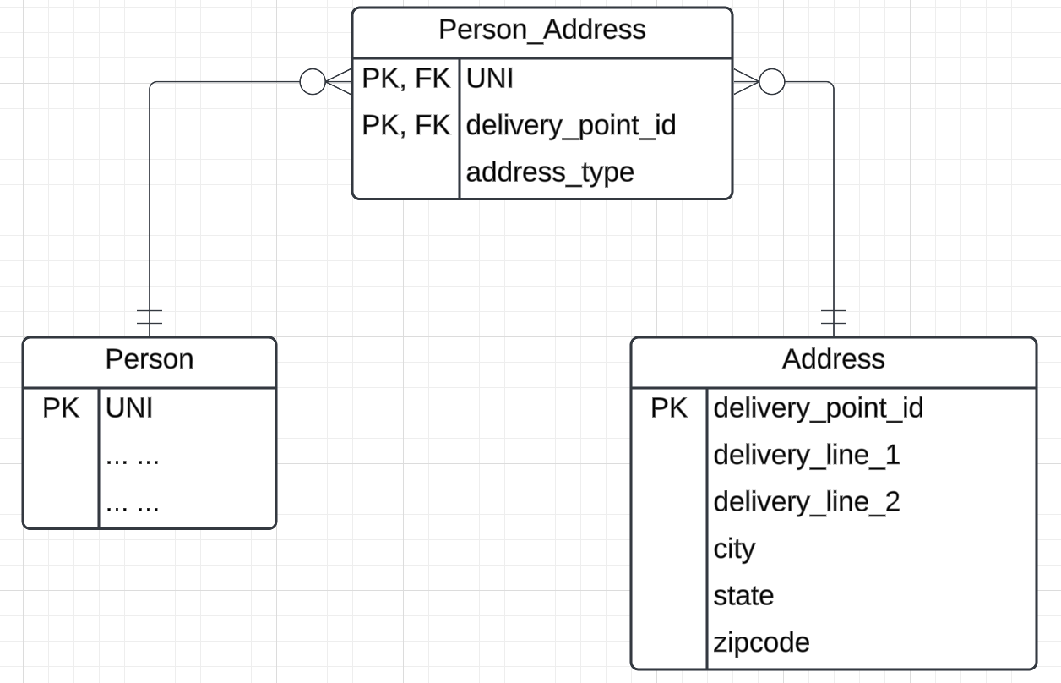
User Profile
People are notoriously bad at entering addresses:
520 w120th street, ny ny
520 West 120th, NYC, NY
520 w 120 street, New York city, NY
… …
Every address has a canonical format.

Slide 62
Accessing SQL from a Programming Language (Cont.)
There are two approaches to accessing SQL from a general-purpose programming language
A general-purpose program -- can connect to and communicate with a database server using a collection of functions
Embedded SQL -- provides a means by which a program can interact with a database server.
The SQL statements are translated at compile time into function calls.
At runtime, these function calls connect to the database using an API that provides dynamic SQL facilities.

Slide 63
Some Terms
“A database connection is a facility in computer science that allows client software to talk to database server software, whether on the same machine or not. A connection is required to send commands and receive answers, usually in the form of a result set.” (https://en.wikipedia.org/wiki/Database_connection)
Session:
“Connection is the relationship between a client and a MySQL database. Session is the period of time between a client logging in (connecting to) a MySQL database and the client logging out (exiting) the MySQL database.” (https://stackoverflow.com/questions/8797724/mysql-concepts-session-vs-connection)
“A session is just a result of a successful connection.”
Network protocols are layered. You can think of:
Connection as the low-level network connection.
Session is the next layer up and has additional information associated with it, e.g. the user.
Connection libraries like pymysql sometimes blur the distinction.

Slide 64
Concepts
MySQL Workbench
… … … …
DataGrip
Relational Database Management System Instance
Blocks Files Records Offsets … …
SQL commands and result sets flow over connection in a session.
Jupyter Notebook
Logically implements query, update, insert, delete, … operations on tables.
Physical layout managed by the DBMS is not tables and is very different.
Web Application
… …
… …

Slide 65

Simplistic View
Your Application Code
Your Application Code
Execute(“Some SQL Statement”)
General DBMS Runtime Including Networking
Language Binding/ Connector
Worked Task with User ID/Role
Native Connector mysqlconnector
TCP/IP
Network Messages
Operating System

Slide 66
Transactions
A transaction consists of a sequence of query and/or update statements and is a “unit” of work
The SQL standard specifies that a transaction begins implicitly when an SQL statement is executed.
The transaction must end with one of the following statements:
Commit work. The updates performed by the transaction become permanent in the database.
Rollback work. All the updates performed by the SQL statements in the transaction are undone.
Atomic transaction
either fully executed or rolled back as if it never occurred
Isolation from concurrent transactions
Show connecting
Explain auto-commit

Slide 67
REST and Web Applications
Introduction
67 | COMS W4111_002_2025_1 - Lecture 6: ER(5), Relational(5), SQL(5) © Donald F. Ferguson, 2025

Slide 68
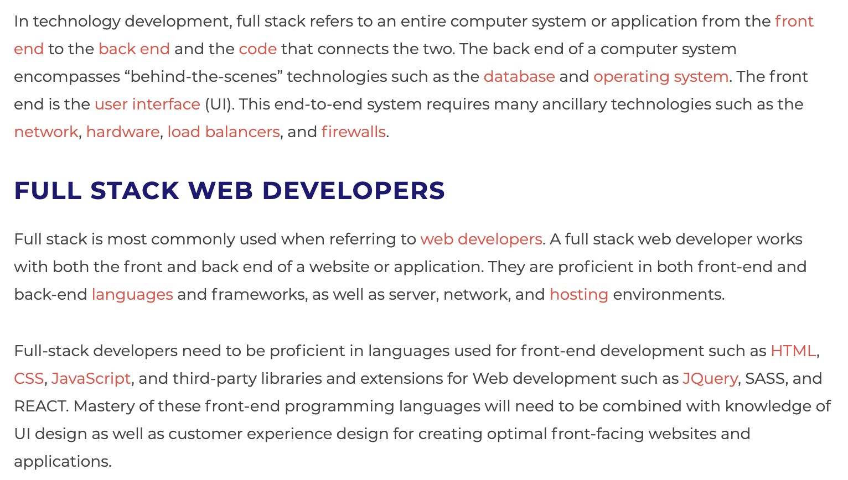
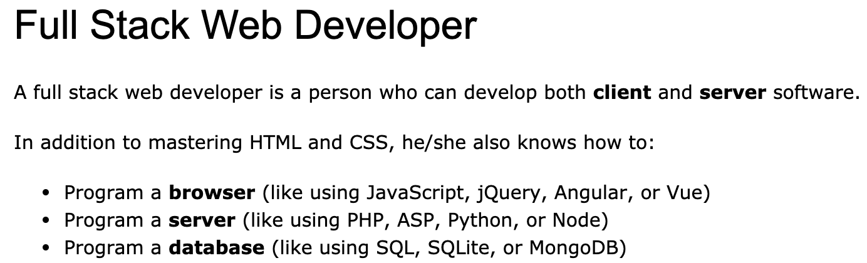
Full Stack Application
https://www.w3schools.com/whatis/whatis_fullstack.asp
There are courses that cover topics:
COMS W4153: Advanced Software Engineering
COMS W4111: Introduction to Databases
COMS W4170 - User Interface Design
This course will focus on cloud realization, microservices and application patterns, ... ...
Also, I am not great at UIs ... ... We will not emphasize or require a lot of UI work.
https://www.webopedia.com/definitions/full-stack/

Slide 69
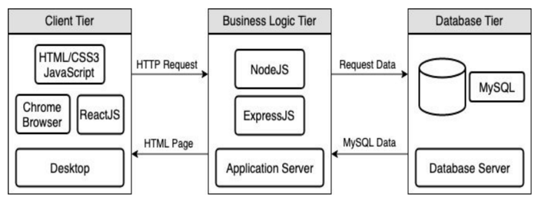
Full Stack Web Application
M = Mongo
E = Express
R = React
N = Node
I start with FastAPI and MySQL, but all the concepts are the same.
https://levelup.gitconnected.com/a-complete-guide-build-a-scalable-3-tier-architecture-with-mern-stack-es6-ca129d7df805
My preferences are to replace React with Angular, and Node with Flask.
There are three projects to design, develop, test, deploy, ... ...
Browser UI application.
Microservice.
Database.
We will initial have two deployments: local machine, virtual machine. We will ignore the database for step 1.

Slide 70
Some Terms
A web application server or web application framework: “A web framework (WF) or web application framework (WAF) is a software framework that is designed to support the development of web applications including web services, web resources, and web APIs. Web frameworks provide a standard way to build and deploy web applications on the World Wide Web. Web frameworks aim to automate the overhead associated with common activities performed in web development. For example, many web frameworks provide libraries for database access, templating frameworks, and session management, and they often promote code reuse.” (https://en.wikipedia.org/wiki/Web_framework)
REST: “REST (Representational State Transfer) is a software architectural style that was created to guide the design and development of the architecture for the World Wide Web. REST defines a set of constraints for how the architecture of a distributed, Internet-scale hypermedia system, such as the Web, should behave. The REST architectural style emphasises uniform interfaces, independent deployment of components, the scalability of interactions between them, and creating a layered architecture to promote caching to reduce user-perceived latency, enforce security, and encapsulate legacy systems.[1] REST has been employed throughout the software industry to create stateless, reliable web-based applications.” (https://en.wikipedia.org/wiki/REST)

Slide 71
Some Terms
OpenAPI: “The OpenAPI Specification, previously known as the Swagger Specification, is a specification for a machine-readable interface definition language for describing, producing, consuming and visualizing web services.” (https://en.wikipedia.org/wiki/OpenAPI_Specification)
Model: “A model represents an entity of our application domain with an associated type.” (https://medium.com/@nicola88/your-first-openapi-document-part-ii-data-model-52ee1d6503e0)
Routers: “What fastapi docs says about routers: If you are building an application or a web API, it’s rarely the case that you can put everything on a single file. FastAPI provides a convenience tool to structure your application while keeping all the flexibility.” (https://medium.com/@rushikeshnaik779/routers-in-fastapi-tutorial-2-adf3e505fdca)
Summary:
These are general concepts, and we will go into more detail in the semester.
FastAPI is a specific technology for Python.
There are many other frameworks applicable to Python, NodeJS/TypeScript, Go, C#, Java, … …
They all surface similar concepts with slightly different names.

Slide 72
REST (https://restfulapi.net/)
What is REST
REST is acronym for REpresentational State Transfer. It is architectural style for distributed hypermedia systems and was first presented by Roy Fielding in 2000 in his famous dissertation.
Like any other architectural style, REST also does have it’s own 6 guiding constraints which must be satisfied if an interface needs to be referred as RESTful. These principles are listed below.
Guiding Principles of REST
Client–server – By separating the user interface concerns from the data storage concerns, we improve the portability of the user interface across multiple platforms and improve scalability by simplifying the server components.
Stateless – Each request from client to server must contain all of the information necessary to understand the request, and cannot take advantage of any stored context on the server. Session state is therefore kept entirely on the client.
Cacheable – Cache constraints require that the data within a response to a request be implicitly or explicitly labeled as cacheable or non-cacheable. If a response is cacheable, then a client cache is given the right to reuse that response data for later, equivalent requests.
Uniform interface – By applying the software engineering principle of generality to the component interface, the overall system architecture is simplified and the visibility of interactions is improved. In order to obtain a uniform interface, multiple architectural constraints are needed to guide the behavior of components. REST is defined by four interface constraints: identification of resources; manipulation of resources through representations; self-descriptive messages; and, hypermedia as the engine of application state.
Layered system – The layered system style allows an architecture to be composed of hierarchical layers by constraining component behavior such that each component cannot “see” beyond the immediate layer with which they are interacting.
Code on demand (optional) – REST allows client functionality to be extended by downloading and executing code in the form of applets or scripts. This simplifies clients by reducing the number of features required to be pre-implemented.

Slide 73
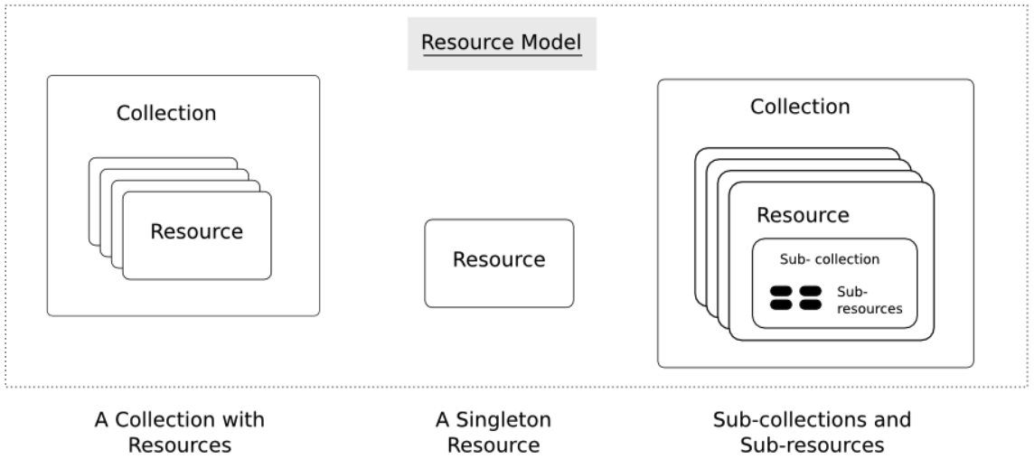
Resources
Resources are an abstraction. The application maps to create things and actions.
“A resource-oriented API is generally modeled as a resource hierarchy, where each node is either a simple resource or a collection resource. For convenience, they are often called a resource and a collection, respectively.
A collection contains a list of resources of the same type. For example, a user has a collection of contacts.
A resource has some state and zero or more sub-resources. Each sub-resource can be either a simple resource or a collection resource.
For example, Gmail API has a collection of users, each user has a collection of messages, a collection of threads, a collection of labels, a profile resource, and several setting resources.
While there is some conceptual alignment between storage systems and REST APIs, a service with a resource-oriented API is not necessarily a database, and has enormous flexibility in how it interprets resources and methods. For example, creating a calendar event (resource) may create additional events for attendees, send email invitations to attendees, reserve conference rooms, and update video conference schedules. (Emphasis added) (https://cloud.google.com/apis/design/resources#resources)
https://restful-api-design.readthedocs.io/en/latest/resources.html

Slide 74
REST – Resource Oriented
When writing applications, we are used to writing functions or methods:
openAccount(last_name, first_name, tax_payer_id)
account.deposit(deposit_amount)
account.close()
We can create and implement whatever functions we need.
REST only allows four methods:
POST: Create a resource
GET: Retrieve a resource
PUT: Update a resource
DELETE: Delete a resource
That’s it. That’s all you get.
A REST client needs no prior knowledge about how to interact with any particular application or server beyond a generic understanding of hypermedia.
“The key characteristic of a resource-oriented API is that it emphasizes resources (data model) over the methods performed on the resources (functionality). A typical resource-oriented API exposes a large number of resources with a small number of methods.” (https://cloud.google.com/apis/design/resources)

Slide 75
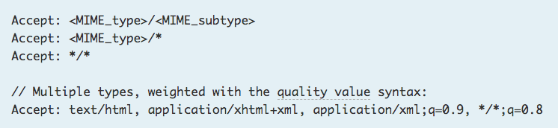
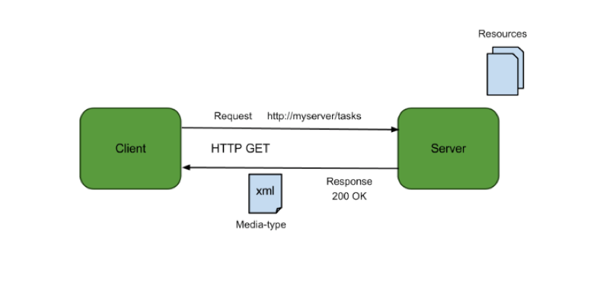
Resources, URLs, Content Types
Relative URL identifies “resource” on the server.
Server implementation maps abstract resource to tangible “thing,” file, DB row, … and any application logic.
Accept type in headers.
Client may be
Browser
Mobile device
Other REST Service
… …
Web media (content) type, e.g.
text/html
application/json

Slide 76
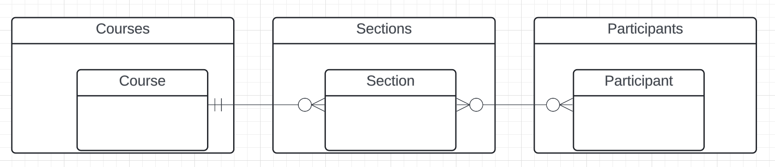
Resources and APIs
Base resources, paths and methods:
/courses: GET, POST
/courses/<id>: GET, PUT, DELETE
/sections: GET, POST
/sections/<id>: GET, PUT, DELETE
/participants: GET, POST
/participants/<id>: GET, PUT, DELETE
There are relative, navigation paths:
/courses/<id>/sections
/participants/<id>/sections
etc.
GET on resources that are collections may also have query parameters.
There are two approaches to defining API
Start with OpenAPI document and produce an implementation template.
Start with annotated code and generate API document.
In either approach, I start with models.
Also,
I lack the security permission to update CourseWorks.
I can choose to not surface the methods or raise and exception.

Slide 77
Data Modeling Concepts and REST
Almost any data model has the same core concepts:
Types and instances:
Entity Type: A definition of a type of thing with properties and relationships.
Entity Instance: A specific instantiation of the Entity Type
Entity Set Instance: An Entity Type that:
Has properties and relationships like any entity, but ...
Has at least one special relationship – contains.
Operations, minimally CRUD, that manipulate entity types and instances:
Create
Retrieve
Update
Delete
Reference/Identify/... ...
Host/database/table/pk

Slide 78
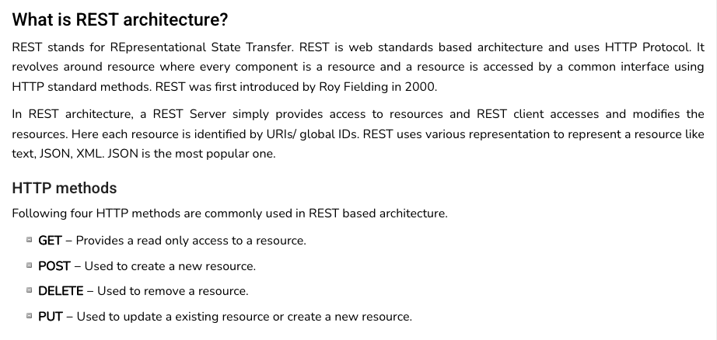
REST (https://www.tutorialspoint.com/restful/restful_introduction.htm)

Slide 79
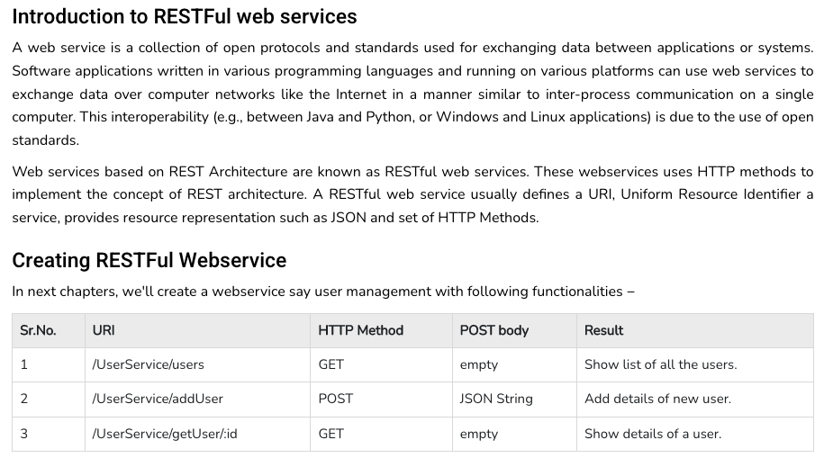
REST (https://www.tutorialspoint.com/restful/restful_introduction.htm)

Slide 80
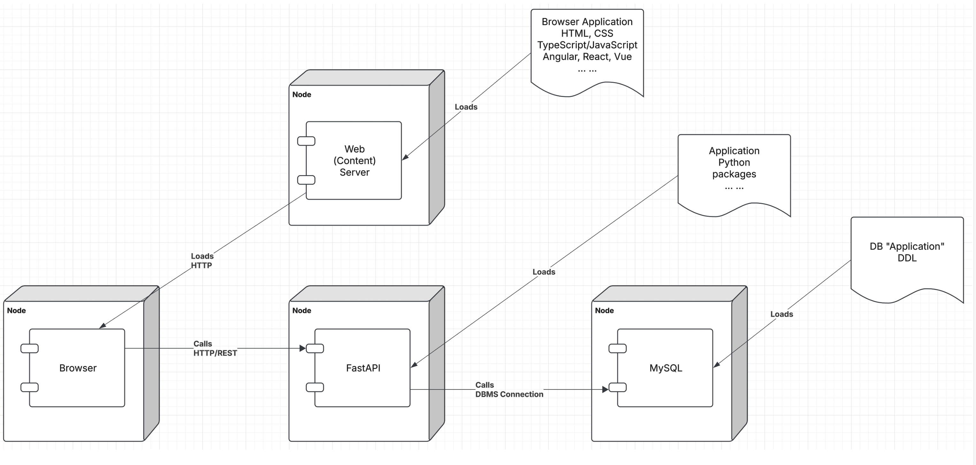
Let’s Look at the Programming Project

Slide 81
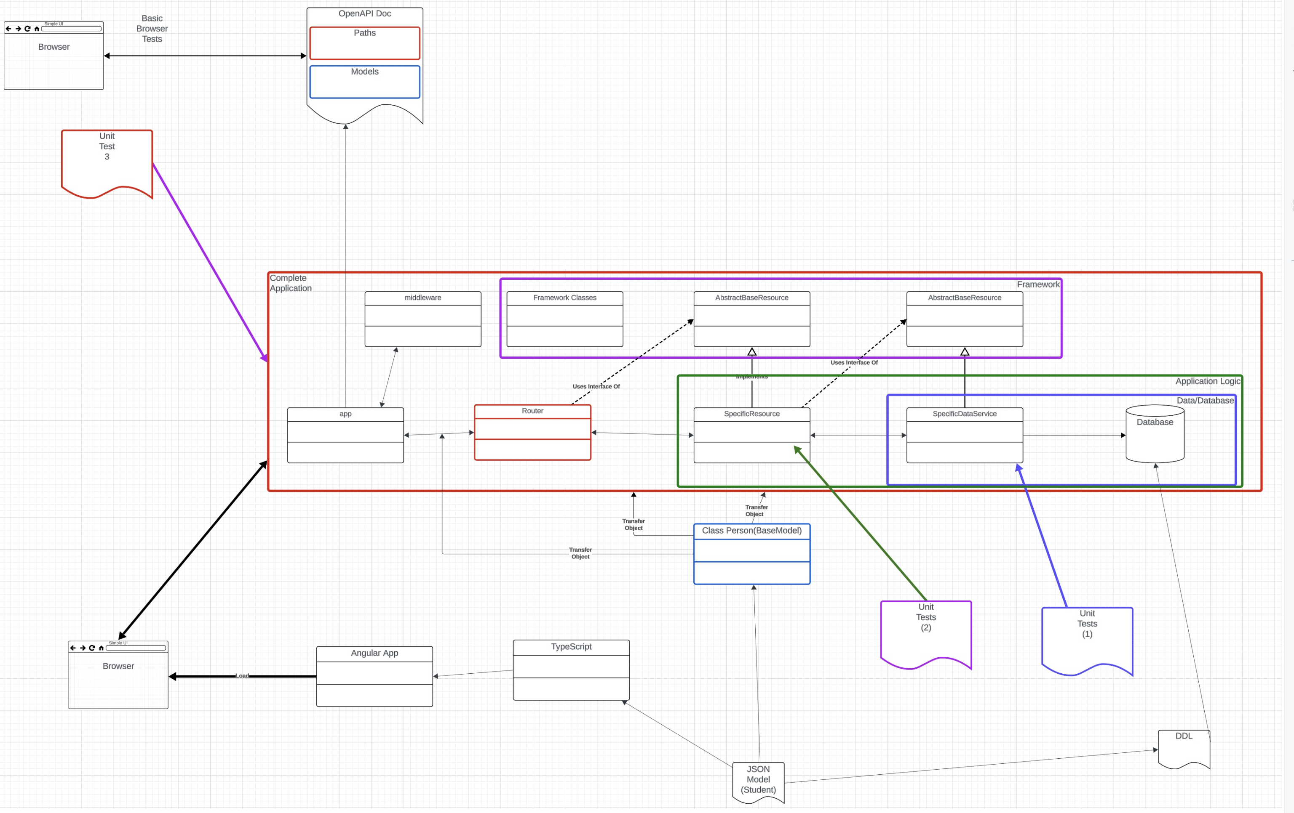
Let’s Look at the Programming Project

Slide 82
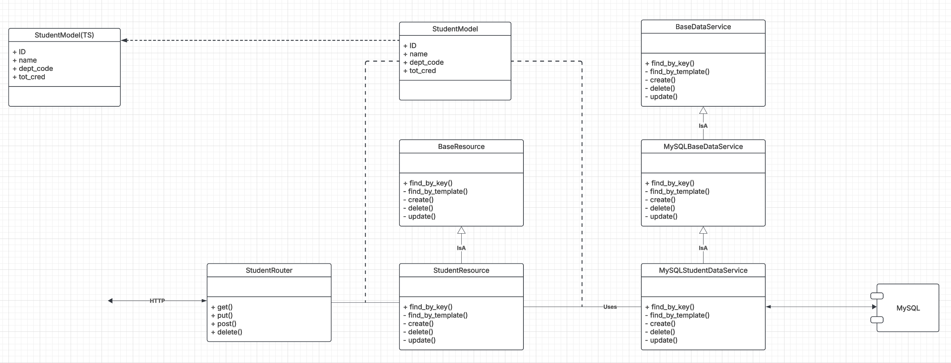
Let’s Look at the Programming Project

Slide 83
Backup

